Slide 1
Personal Requirement
CH # 4
(Facility System design, support system)

Slide 2
4.1 Introduction
The planning of personnel requirements includes planning for:
Employee parking,
Locker rooms,
Restrooms,
Food services,
Drinking fountains, and
Health services.

Slide 3
Personnel requirement is most difficult to plan because of number of philosopies
Philosophies relating to personnel:
• “Our firm is responsible for our employees from the moment they leave their home until they return. We must provide adequate methods of getting to and from work”.
• “Employees spend one third of their life within our facility; we must help them enjoy working here”.
Happy worker is the productive worker.
A hot Lunch makes workers more productive since it supplies them energy.
4.2. The Employee-Facility Interface
An interface between an employee’s work and nonwork activities must be provided.
4.2.1. Employee Parking
The procedure of planning employee parking:
1. Determine the number of automobiles to be parked.
2. Determine the space required for each automobile.
3. Determine the available space for parking.
4. Determine alternative parking layouts for alternative parking patterns.
5. Select the layout that best utilizes space and maximizes employee convenience.

Slide 4
The factors to be considered in determining the specification for a specific parking lot
are:
1. The percentage of automobiles to be parked that are compact automobiles. As a planning guideline, if more specific data are not available, 33% of all parking is often allocated to compact automobiles.
2. Increasing the area provided for parking decreases the amount of time required to park and de-park.
3. Angular configurations allow quicker turnover; perpendicular parking yields greater space utilization.
4. As the angle of parking space increases, so does the required space allocated to aisles.

Slide 5
Example 4.1
A new facility is to have 200 employees. A survey of similar facilities that one parking space must be provided for every two employees and that 40% of all automobiles driven to work are compact automobiles. Five percent of the spaces should be allocated for the handicapped. The available parking lot space is 180 ft and 200 ft deep. What is the best parking layout?
4.2.2. Storage of Employees Personal Belongings
A location for storage of employee personal belongings should be provided between the employee entrance and work area. Employees typically store lunches, briefcases, and purses at their place of work.
For changing of clothes Lockers room is required. Some times it is not required as some times person need not to be worked in hazardous stage.

Slide 6
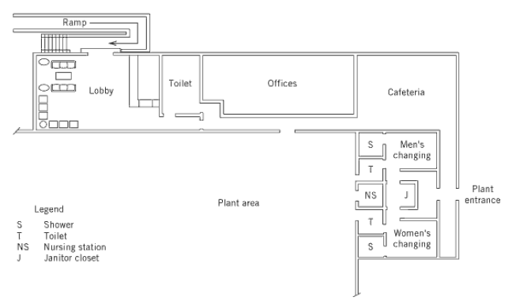
If shower facilities are to be provided, they should be located in the locker room. Sinks and mirrors are also typically included there. If toilet facilities are to be included, they must be physically separated from the locker room area (should lunches be stored in the locker).

Slide 7
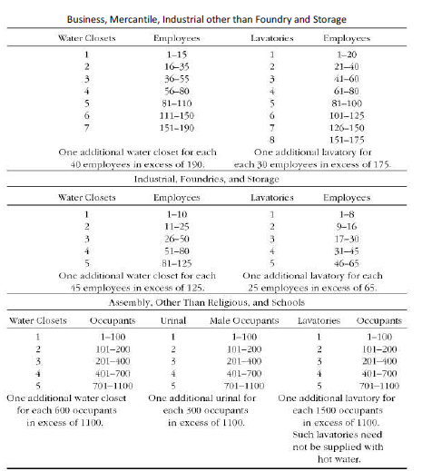
4.3. Restrooms
A restroom should be located within 200 ft of every permanent workstation. Decentralized restrooms often provide greater employee convenience than large, centralized restrooms. Access to restrooms must be available to handicapped employees. Hence, some restrooms must be at ground level.

